Slide 1
regression

Slide 2
Linear regression
In correlation, the two variables are treated as equals. In regression, one variable is considered independent (=predictor) variable (X) and the other the dependent (=outcome) variable Y.

Slide 3
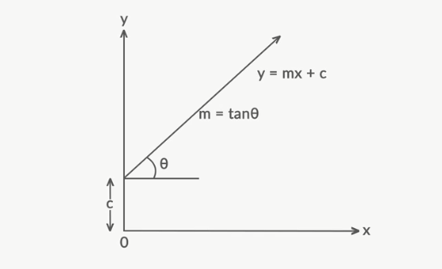
What is “Linear”?
Remember this:
Y=mX+c?

Slide 4
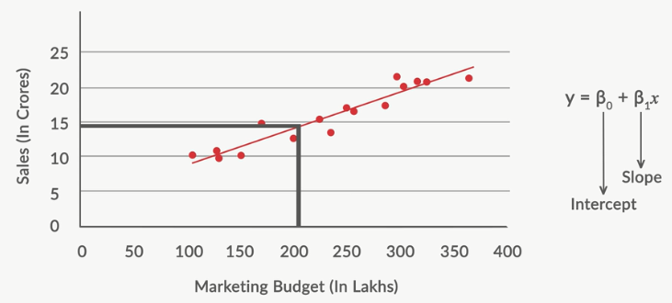
What’s Slope?
A slope of 2 means that every 1-unit change in X yields a 2-unit change in Y.

Slide 5
Prediction
If you know something about X, this knowledge helps you predict something about Y.
Independent variable - X
Dependent variable -Y

Slide 6
Predicted value for an individual…
y_{i}= α + β*x_{i} + random error_{i}
Fixed – exactly on the line
Follows a normal distribution

Slide 7
Assumptions (or the fine print)
Linear regression assumes that…
1. The relationship between X and Y is linear
2. Y is distributed normally at each value of X
3. The variance of Y at every value of X is the same (homogeneity of variances)
4. The observations are independent

Slide 8
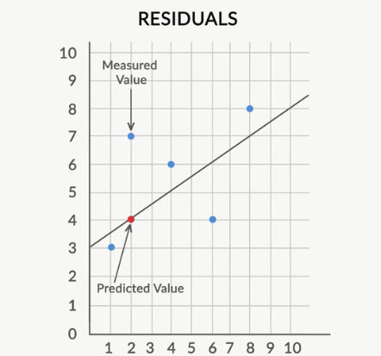
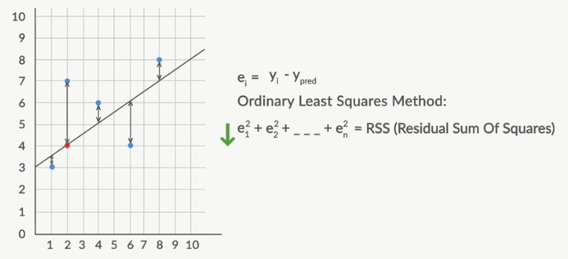
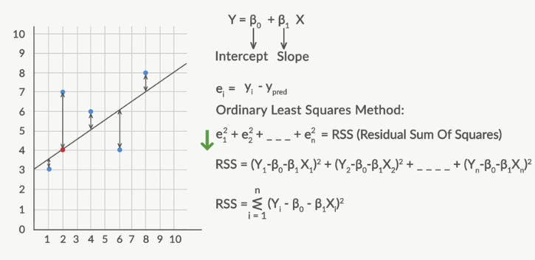
Best Fit Line
The line which fits the given scatter-plot in the best way
Residual
Formula for residual
Error = Yi– Ypred
Or
Ordinary Least square method
RSS
Error in terms of equation of line
Y = mx+c
Minimise Residual to get the best fit line
ie. Get the values of slope and intercept
Residual
7 – 3 =4

Slide 9
Cost function
Define the problem
Minimize or maximize the Cost function
In linear regression
Residual is cost function
The ways to find maximum and minimum
Differentiation
Gradient descent
Start with a value and reduce error gradually

Slide 10

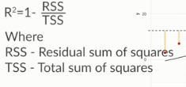
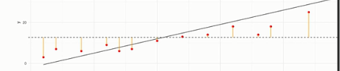
Demo of LR
RSS is absolute , So we have TSS
TSS
Total sum of error
Take the mean line and create the best fit line
and the square of diff of point gives TSS
Lets see it n excel
RSS/TSS - Gives how better is model compared to average line

Slide 11
Residual Analysis for Linearity
Y
Y
x
x
residuals
x
x
residuals
Not Linear
✓
Linear
Slide from: Statistics for Managers Using Microsoft® Excel 4th Edition, 2004 Prentice-Hall

Slide 12
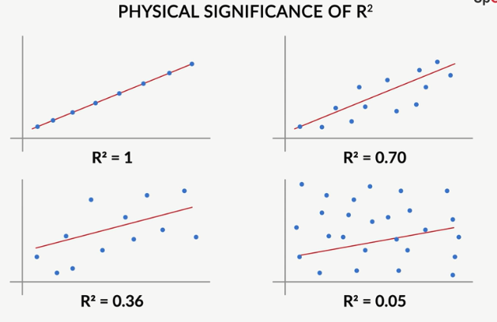

Slide 13
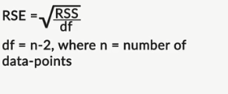
RSE
RSE (Residual Square Error)
Absolute value
Use R square method instead

